Slide 1



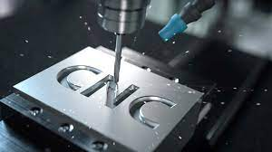

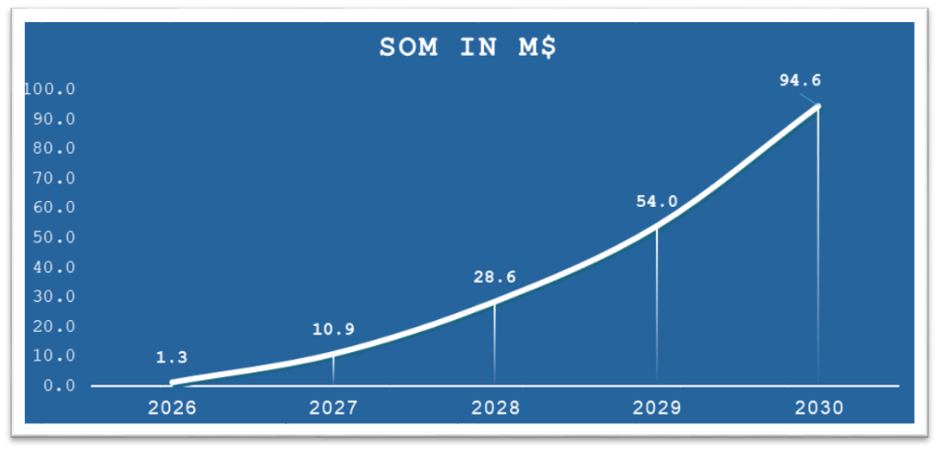
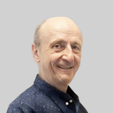
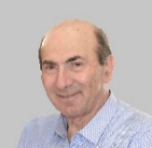


TemperChip™
Beni Manes – COO & VP Business Development
+972 52-3663-181
bmanes1950@gmail.com
www.BYMsystems.com
About us –Vast experienced team in CNC manufacturing. Special expertise on machining processes of composites and other challenging materials.
Mission - We harness novel technologies to optimize CNC process and its quality
`
PROBLEM
SOLUTION
Work piece damage due to overheating.
Real time sensor integrated within the machine tool holder.
Indicates when reaching selected temperature.
Communicates with CNC machine controller.
$
Dramatic losses due to machined part overheating
PRODUCT ADVANTAGES
Prevents dramatic loses of machined parts ,raw material & tools .
Complies with quality requirement of leading Manufacturers.
Challenge to comply with mandatory quality requirement of leading industrial players
Contributes to a faster production turnaround time.
Cost-effective & easy to implement.
TARGET MARKET
ASK & USE OF FUNDING
Aerospace & defense, Automotive, Commodities
Funds Asked
2M$
Founder Investment to date
5.3M$
Tools Market Size ($ B)
Patent Value & product status
7.0 M$
Enhance design
Ramp-U Production
$2M
Against 14%
equity
CAGR 5.6
Go to Market
CORE TEAM:
SALES PROJECTION:
Vision + Passion + Expertise
Yacov Manes
Founder & CEO
Over 4 decades experience in CNC patents & solutions. Inventor
Beni Manes
Co- Founder& COO
Mechanical engineer,
Former GM, IAI / Aero Assembly division
Sales M$
Gross Margin ($M)
Eli Yudkevich
Co-Founder & VP R&D
Mechanical engineer and aerospace manufacturing specialist.
Moti Baron
Co-Founder & CTO
Mechanical engineer,
expert in machining
tools manufacturing & implementation.
65% Average Gross Margin
ROI , less than 2 years,

